Slide 1


SQL Server Replication
Presented by Tarek Ghazali
IT Technical Specialist
Microsoft SQL Server MVP
Web Development MCP
LebDev Vice President
© 2006 Tarek Ghazali. All rights reserved.

Slide 2
Replication Overview
What is Replication?
  “a set of technologies for copying and distributing data and database objects from one database to another and then synchronizing between databases to maintain consistency”
Transactional Replication
  Server to Server solution
Merge Replication
  Offline Database Client solution
Snapshot Replication
  Point in time copy of objects from one database to another

Slide 3
Should I use replication?
Replication is data distribution
Replication may not always be the best solution
Other options are
  Distributed Transactions
    Software-MSDTC
  Backup/Restore
  Log Shipping (continuous Backup/Restore)
  Linked Servers
  Distributed Transactions
  Triggered Solution
  DTS/SSIS
  Clustering
  Hardware/Software Data Mirroring
Ordered by cost of latency/downtime

Slide 4
Business Problems That Require Replication
Multiple users or locations need copies of the same data
  Remote users at distant locations
  Mobile disconnected users
Need to improve local performance
  Physically separate data based on usage
  Distribute database processing across multiple servers
  Scale out read-only data

Slide 5
Customer Scenarios
Offloading reporting and Data Warehousing
Database scale out for websites
Empowering mobile users
Enabling Point of Sale applications
Consolidating and distributing regional data
Integrating heterogeneous data

Slide 6
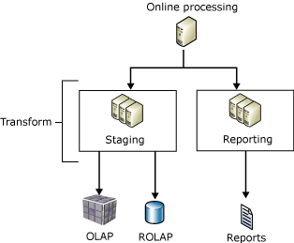
Reporting and Data Warehousing
Reporting databases are continuously synchronized in near real-time with one or more source OLTP databases

Slide 7
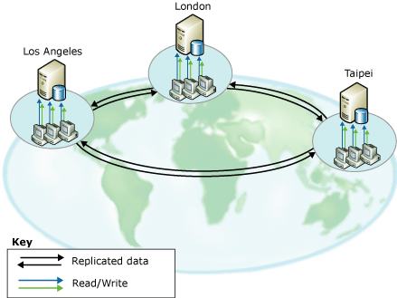
Database Scale Out
Chicago
Queries scaled out (often geographically) similar to reporting cases
Redundancy provides fault tolerance and lowers maintenance downtime
Online upgrades possible
Maximize website uptime
  (Database upgrades or failures shouldn’t bring down the application system)
London
Tokyo
Notes:
Scale-out architectures provide more processing power, but in a different direction. It's splitting up the workload over many different servers, so each individual server need only be powerful enough to handle the load of a smaller percentage of the overall systems.

Slide 8
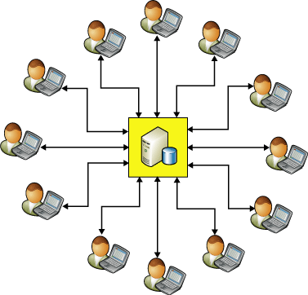
Mobile User
(Sales Orders Scenario)

Slide 9
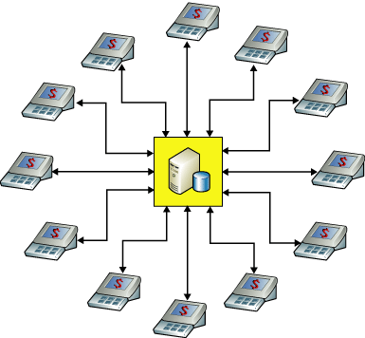
Point of Sale Scenario
  High latency low bandwidth network
  Need low cost software and administration
  Sync at scheduled times
  Upload orders then remove

Slide 10
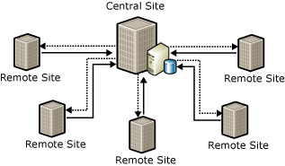
Regional Replication Scenario
Central headquarters data replicated to 1200 stores
Each store also replicates between two databases to provide a backup in case one fails
Database administrators are centralized

Slide 11
The Publisher-Subscriber Metaphor
Publisher
Subscriber
Maintains source databases
Makes data available for replication
Receives data changes
Holds copy of data
Distributor
Stores metadata, history, and receives and stores changes
May forward changes to Subscribers

Slide 12
Publications and Articles
Publications
  One or more articles
  Basis of subscription
  One or more per database
Articles
  All tables or parts of tables
  Views
  Stored procedures
  User-defined functions

Slide 13
Subscriptions
Subscriber
Pull subscription
Publication
Push subscription
Subscriber

Slide 14
Remote Distributor
Subscribers
Publisher
Distributor

Slide 15
Local Distributor
Publisher/
Distributor
Subscribers

Slide 16
SQL Server
Replication Types
Microsoft SQL Server supports the following types of replication:
Snapshot Replication
Transactional Replication /Updatable subscriptions for transactional replication
Merge Replication

Slide 17
What Is Snapshot Replication?
Distributes data as it appears at a moment in time
This type is mostly used when the amount of data to be replicated is small and data/DB objects are static or does not change frequently.

Slide 18
What Is Transactional Replication?
Permits immediate replication of data modifications
  Minimal latency is required
Publisher and the subscriber are always in synchronization and should always be connected.
This type is mostly used when subscribers always need the latest data for processing.

Slide 19
What Is Merge Replication?
Merges the updates between sites when they are connected
Multiple Subscribers need to update at various times
Subscribers need to receive data, make changes offline, and later synchronize changes with the Publisher and other Subscribers.
Each Subscriber requires a different partition of data

Slide 20
Replication Agents
Snapshot
Transactional
Merge
Snapshot Agent
Snapshot Agent
Snapshot Agent
Distribution Agent
Distribution Agent
Log Reader Agent
Merge Agent
Queue Reader Agent
Agents are the processes that are responsible for copying and distributing data between publisher and subscriber. There are different types of agents supporting different types of replication.
Notes:
Merge agent can reside either on a publisher (push subscriptions) or on subscribers (pull subscriptions)

Slide 21

Multimedia: Microsoft SQL Server Replication
This animation reviews the concepts behind SQL Server replication.
  Snapshot replication
  Transactional replication
  Merge replication

Slide 22
Break

Slide 23
Replication in
SQL Server 2005
Focused on your requests
  Monitoring & diagnostics
  Oracle Publishing
  Transactional
    Better high availability story
    Initialization from backup
  Merge
    Performance
    “Logical record” consistency
    Synchronization over the web
  Schema changes made using the following data definition language (DDL) statements are automatically replicated
  Wizard simplicity
  Great documentation!

Slide 24
Replication Monitoring (Goals)
Independent from SQL Server Management Studio
Provide answers to common questions
  Why is the system slow?
  How long until it catches up or finishes?
    Estimate how long it will take for subscribers to catch up
  Where are the potential problems?

Slide 25
Oracle Publishing
Transactional Replication
Designed specifically for Oracle Publishers
  v8+ on any operating system
Administered like SQL Server, from SQL Server
  No Oracle side software install necessary
  Requires minimal knowledge of Oracle
Yukon
Distributor
Subscribers

Slide 26
Peer to Peer Replication
Benefits
  High availability & scale out of DB applications
  No single point of failure
  Allows maintenance without taking applications offline
  Can scale queries across databases
Setup
  Create “Tranasactional Publication with Updateable Subscriptions” publications and subscriptions from each database to the other databases
  Publications must all have the same name

Slide 27
Peer To Peer Topology Transactional Replication
Logreader
Agent
Logreader
Agent
Dist
DB
Dist
DB
Distribution
Agent
“South”
Distribution
Agent
Logreader
Agent
“West”
“East”
Dist
DB
Distribution
Agent
Notes:
In peer-to-peer replication, all nodes within the
system are peers, all can be updated, and all
In peer-to-peer replication, all nodes within the
system are peers, all can be updated, and all
receive the changes made at the other nodes.
it is the responsibility of the application to ensure that no conflicts are generated, or that any conflicts are suitably resolved. You can avoid conflicts by ensuring that updates are only permitted at one of the nodes or that updates to each partition of data only occur at one node. If this is not possible, merge replication may be a better solution.

Slide 28
Transactional - Initialization using a DB Backup
Benefits
  Restore a publisher DB backup to deliver the initial data to a subscriber (instead of snapshot)
  Subscriber automatically picks up subsequent changes on the publisher that occurred after the backup
Setup
  Set the “allow initialization with backup” publication option
  Restore a subsequent publisher backup to the subscriber

Slide 29
Merge Replication Performance Improvements
Differing levels of conflict detection improve performance
  Download only
    Data is read only and can only be modified on publisher (for example, lookup data, salary, etc.)
    No metadata sent to subscriber
  Subscription based filtering
    Changes occur at only one subscriber (Point of Sale, Package Delivery)
    Metadata is minimal and cleaned up at completion of sync
  Partition based filtering
    Changes occur within a workgroup (CRM, sales management [SFA])
    Conflicts can be resolved amongst common peers
    Metadata is present; however, performance is improved when applying changes to publisher

Slide 30
Parameterized Row Filter Partition Values
Description | Value in Add Filter and Edit Filter | Value in Article Properties
Data in the partitions is overlapping, and the Subscriber can update columns referenced in a parameterized filter. | A row from this table will go to multiple subscriptions | Overlapping
Data in the partitions is overlapping, and the Subscriber cannot update columns referenced in a parameterized filter. | N/A¹ | Overlapping, disallow out-of-partition data changes
Data in the partitions is not overlapping, and the data is shared between subscriptions. The Subscriber cannot update columns referenced in a parameterized filter. | N/A¹ | Nonoverlapping, shared between subscriptions
Data in the partitions is not overlapping, and there is a single subscription per partition. The Subscriber cannot update columns referenced in a parameterized filter.² | A row from this table will go to only one subscription | Nonoverlapping, single subscription
1 If the underlying filtering option is set to 0, or 1, or 2, the Add Filter and Edit Filter dialog boxes will display A row from this table will go to multiple subscriptions.
2 If you specify this option, there can only be a single subscription for each partition of data in that article. If a second subscription is created in which the filtering criterion of the new subscription resolves to the same partition as the existing subscription, the existing subscription is dropped.

Slide 31
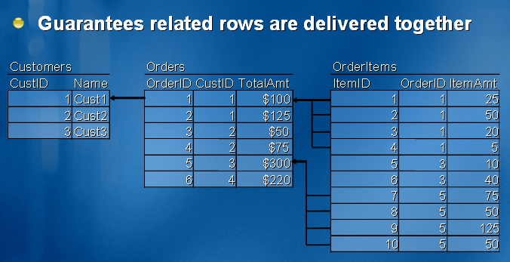
Logical Records
Merge Replication

Slide 32
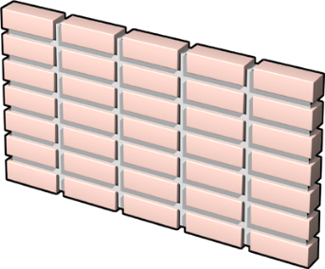
Web Synchronization
Merge Replication
XML over HTTPS
Binary over TCP/IP
Subscriber
IIS
Publisher/Distributor
Replisapi.dll
No VPN or port required
Eases deployment of mobile applications
Off by default
Secure by default
Only authenticated users can send request
Requires HTTPS
Wizard turns off anonymous access
Firewall

Slide 33
Mapping SQL Server 2005 Data Types
SQL Server 2005 has introduced a number of new data types. These new data types are mapped to compatible data types at the Subscriber if push subscriptions from a SQL Server 2005 Distributor are used.
SQL Server 2005 Data Type | SQL Server 2000 Data Type
XML | NTEXT
CLR User Defined Types (UDT) | IMAGE
VARCHAR(max) | TEXT
NVARCHAR(max) | NTEXT
VARBINARY(max) | IMAGE

Slide 34
Replicating Data to SQL Server Express
Microsoft SQL Server 2005 Express Edition can serve as a Subscriber for all types of replication, providing a convenient way to distribute data to client applications that use this edition of SQL Server.
When using SQL Server 2005 Express Edition in a replication topology, keep the following considerations in mind:
  SQL Server 2005 Express Edition cannot serve as a Publisher or Distributor. However, merge replication allows changes to be replicated in both directions between a Publisher and Subscriber.
  SQL Server 2005 Express Edition does not include SQL Server Agent, which is typically used to run replication agents. If you use a pull subscription (in which agents run at the Subscriber), you must synchronize the subscription using Windows Synchronization Manager or RMO.

Slide 35
Contrasting Replication with Other Data Distribution Methods
Method
Autonomy
Latency
Replication
Variable
Variable, depending on type
Distributed transactions
Low
Low
Back up and restore
High
High
Data Transformation (SSIS)
Special use only
Special use only
Notes:
Local Autonomy: Each site should operate independently of the other sites.
No site should depend on another site for its successful functioning.

Slide 36
Break

Slide 37
Demo

Slide 38
Resources & Questions
Microsoft Resources:
  msdn.microsoft.com/sqlserver/
  www.microsoft.com/sql/community
Contact me:
  tghazali@sqlmvp.com
  www.sqlmvp.com
Download Presentation :
  www.lebdev.net
  www.devconnect.net

